Slide 1
Cultural Conformity and Adaptation

Slide 2
It’s a scary thought… but imagine…
You wake up in the middle of the night, roll over in bed and realize it’s 3:25am. As you start to fall back asleep you cough and see that there is smoke in your room. You jump out of bed to the realization that your house is on fire. You have less than 2 minutes to get out of the house.
What do you stop to take out of the house with you? Make a list of items in the order that they come into your head.

Slide 3
Values in Our Society (R. Williams)
(1) Achievement and Success
(2) Individualism
(3) Activity and Work
(4) Efficiency and Practicality
(5) Science and Technology
(6) Progress
(7) Material Comfort
(8) Humanitarianism
(9) Freedom
(10) Democracy
(11) Equality
(12) Racism and Group Superiority
(13) Education
(14) Religiosity
(15) Romantic Love

Slide 4
Traditional American Values
Personal Achievement
Nation built primarily by people who valued individual achievement. Most evident in the area of employment.
Getting ahead at work, attaining wealth, power and prestige
Limitless Clip

Slide 5
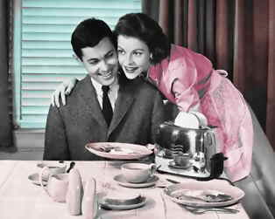
Individualism
Success comes through hard work and initiative – downside, if you don’t succeed, most American believe you are to blame.
Success that comes from individual effort and initiative.

Slide 6
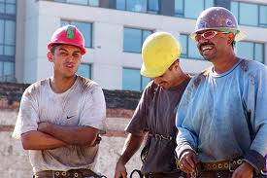
Work
Discipline, dedication, and hard work are viewed as signs of virtue
Busy with activities when not at work.
Those who choose not to work are considered lazy.
Seems to be less important in today’s society.

Slide 7
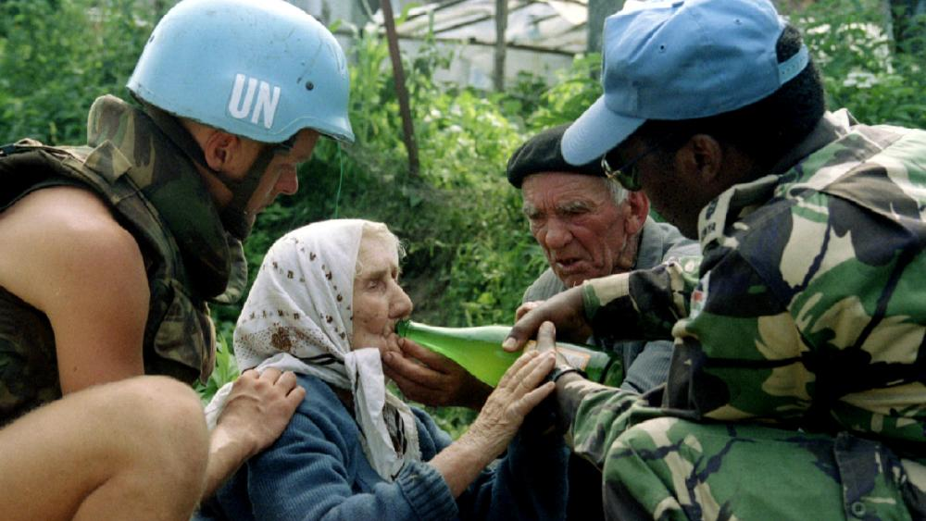
Morality and Humanitarianism
High value is placed on morality and the world is viewed in terms of right and wrong; quick to help the less fortunate.
US was founded on religious faith, justice and equality
Helpfulness, personal kindness, aid in mass disasters

Slide 8
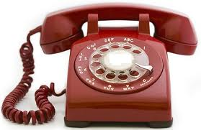
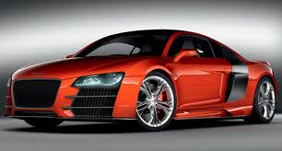
Efficiency and Practicality
Practical and inventive; every problem has a solution; objects are judged on their usefulness and people on their ability to get things done
Americans consider it important to do things fast and constantly seek changes to increase efficiency

Slide 9
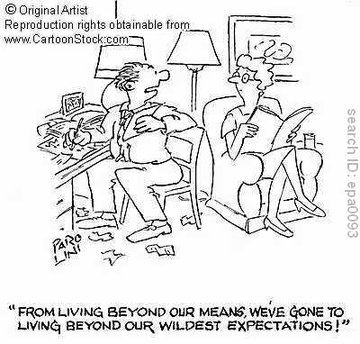
Progress and Material Comfort
Through hard work and determination, living standards will continue to improve
Progress: “more and better” gadgets that will help move towards progress
Material comfort: nutrition, medical care, and housing, etc.

Slide 10
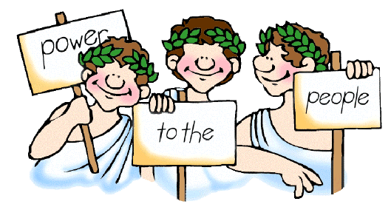
Equality and Democracy
To have human equality, there must be an equality of opportunity; success must be earned
“We hold these truths to be self-evident… all men are created equal.”
Americans believe in equality in the government.

Slide 11
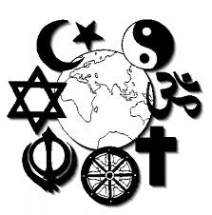
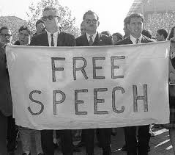
Freedom
Freedoms of choice such as religion, speech, and press must be protected from government interference
Fight to protect these freedoms for direct government interference
Core values of the United States.

Slide 12
Racial and Group Superiority
Contradicts freedom, democracy, and equality.
Americans value some groups more than others and have done so throughout our history.
Native Americans being slaughtered
Japanese camps during WWII
Today… attacks on Immigrants and Muslims

Slide 13
Education
Go as far as you can.
Higher education is considered appropriate.
Apprenticeships are often looked down upon because of the lack of “formal” education.

Slide 14
Values in Our Society (R. Williams)
(1) Achievement and Success
(2) Individualism
(3) Activity and Work
(4) Efficiency and Practicality
(5) Science and Technology
(6) Progress
(7) Material Comfort
(8) Humanitarianism
(9) Freedom
(10) Democracy
(11) Equality
(12) Racism and Group Superiority
(13) Education
(14) Religiosity
(15) Romantic Love

Slide 15
Other Core Values
Nationalism and Patriotism
Belief that American values/institutions represent the best on earth
Science and Rationality
Mastering the environment to secure a better life in terms of material comforts
Religious Values
There is a general feeling that every American should embrace religion
“In God We Trust” on our money; “…one nation under God.”
Romantic Love
Only proper basis for marriage is love
Songs, literature, mass media, and “folk beliefs” all stress this value. “love conquers all”

Slide 16
Think About It…
What new values have developed in the United States since the 1960s and 70s?
See if you can come up with at least 3 or 4.

Slide 17
Maybe some of these…?
Commitment to the full development of one’s personality, talents, and potential;
Self-fulfillment
Leisure
Physical fitness
Youthfulness
Narcissism
Environmental protection
Education and religion were still deemed important by students who were polled

