Slide 1
Sociology – Chapter 1 Theories & People

Slide 2
What is Sociology?
Sociology—the study of human behavior & how humans interact in groups
How do people act in groups?

Slide 3
Conformity
Conformity is how members of a group think, feel, and behave in a similar way.
Can you give some examples of groups and how people conform in them?
What groups do you conform to?

Slide 4
Sociological Perspective
Young men join gangs because they been taught by society to be masculine
Teens commit suicide because of peer group expectations of looks, material things, and performance
Teen pregnancy pact in Massachusetts

Slide 5
Do people act differently in groups?
Yes, in some cases they do!
People’s behavior within a group setting cannot be predicted from their personal characteristics.
Can you think of any examples?

Slide 6
Theories and People
Sociology is a young science
it is one of the “social sciences”
Started in Europe
Spread to United States

Slide 7
Functionalist Theory
Sees society as a system of parts that works together to maintain the cohesion of the whole system
People agree on what is best for society – work to make that run smoothly
Everyone has a function – it is possible to be dysfunctional

Slide 8
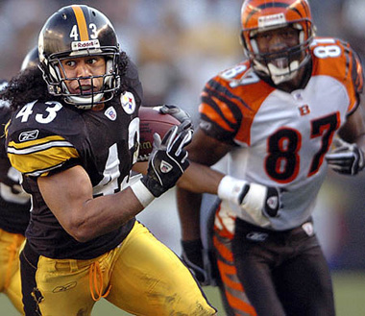
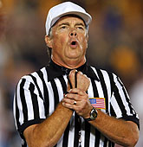
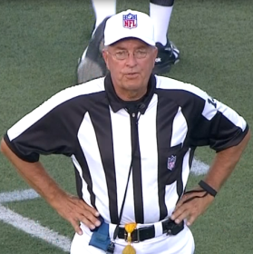
Functionalist Theory
Think of it in terms of football…
Each person has a roll on the team that, when they work together, make a smooth system
If one person doesn’t do what they are suppose to do (think of penalties in the game!) it creates a dysfunction in the system
Make more sense?
Notes:
In society, things like CRIME are dysfunctional

Slide 9
Functionalist Theory
Manifest Function – intended and recognized consequence of some element of society
Ex: Function of a car to get from one place to the next fairly quickly
Latent Function – unintended consequence of an element of society
Ex: Car becomes a symbol of status and wealth

Slide 10
Auguste Comte
Father of Sociology
Scientific Study of Society
Positivism - knowledge should be derived from scientific observation
Social Dynamics - the study of social change
Notes:
Studies in the late 1700s – what happened in Europe that Comte can use his new found advanced knowledge to begin to study the behaviors of people

Slide 11
Harriet Martineau
Translated Comte’s work into English
Wrote about the inferior role of women in society
Supported the end of slavery & rights for women

Slide 12
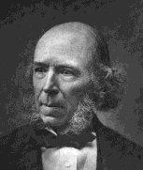
Herbert Spencer
Compared society to the human body
Religious & Educational Institutions crucial to society
Social Darwinism—changes in society led to progress
We should not interfere; no social reform
Survival of the Fittest

Slide 13
Emile Durkheim
Society exists because of an agreement between its members
Use of statistics in research of society
Human behavior must be explained by social factors rather than psychological factors
Notes:
“E-mill Durk-hem” – late 1800s, early 1900s.M

Slide 14
Focuses his studies a lot on religion
Studies suicide rates in Protestants and Catholics
Notes:
Catholic suicide rate is lower because they have a stronger hold on their constituents --

Slide 15
Conflict Theory
Sees society as a collection of parts held together by social powers
Focuses on how those who have power use it over those who don’t have power
Don’t just focus on violence
Men/Women, Age Groups, Racial/Ethnic Backgrounds
Notes:
Looks at decision making in a family setting, power between racial groups, workers and employees

Slide 16
Conflict Theory
Competition of scarce resources is the basis of social conflict
If one group gains control over the resources, how do they then make the rules

Slide 17
Karl Marx
Change the world instead of just studying it
Class conflicts—richer take advantage of the poor
Believed the clash would lead to communism
Planned revolution would speed up the change to communism where all people would be equal

Slide 18
Karl Marx
Bourgeoisie
Upper class
Capitalists
Owned everything
Proletariat
Poor
Working class
Class conflict occurs between the two.

Slide 19
Interaction Theory
Sees society as socially constructed by everyday encounters by everyday people
Focuses on symbols
For something to be a symbol, people must agree on the meaning…
Physical objects, gestures, words and events

Slide 20
What in the world Are these???
#

Slide 21
Interaction Theory
Symbolic Interaction – process of figuring out how people use symbols
Work with the person next to you
You have 2 minutes to come up with examples of symbolic interaction!
When you finish, write a few on the board please!

Slide 22
Max Weber
Believed sociologists must find the personal meanings, values, beliefs, & attitudes underlying human social behavior
Understanding the social behavior of others by mentally putting yourself in their places
“Putting yourself in someone else’s shoes” – what term does this remind us of?

Slide 23
Jane Addams
American social reformer
Co-founded the Hull House in city slum
Active in women’s rights & the peace movement
Saw the effects of industrialization on the poor
Imbalance of power in the social classes
Notes:
Hull House in Chicago – women went there, babies were delivered, taught them to work on their own for themselves, would take in children

Slide 24
W.E.B. DuBois
African American Activist
Analyzed the social structure of the Black community
Worked for African American Rights

